Slide 1
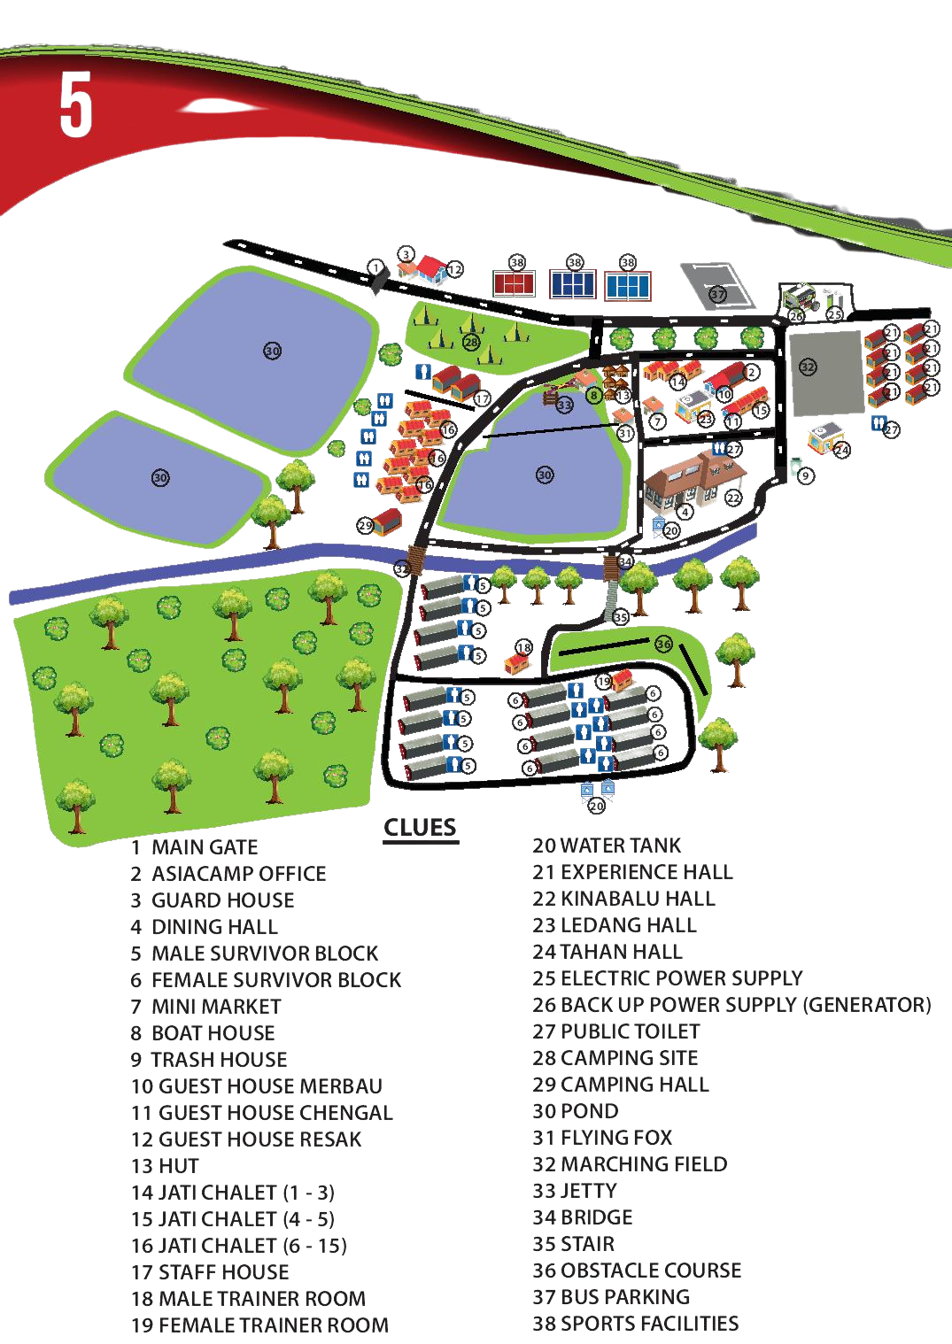









ASIA CAMP SEMENYIH
OUTDOOR
ACTIVITIES

Slide 2
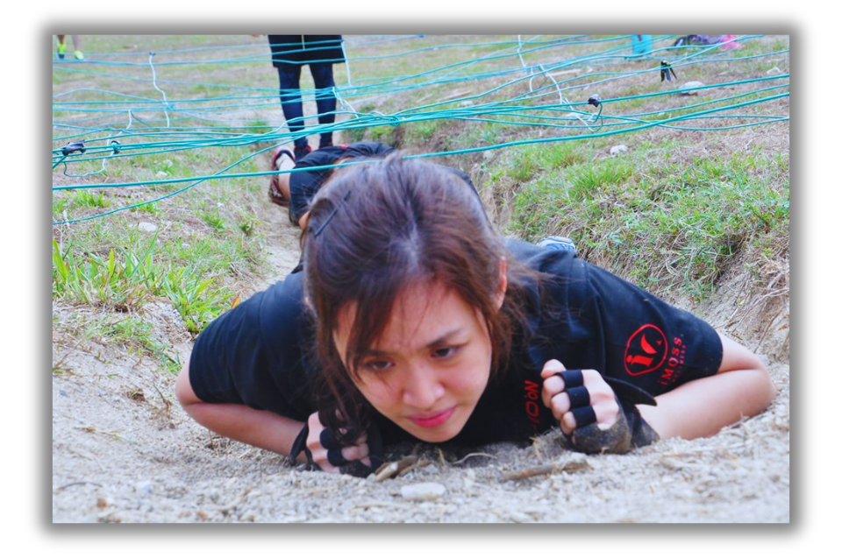
OBSTACLE COURSE

Slide 3
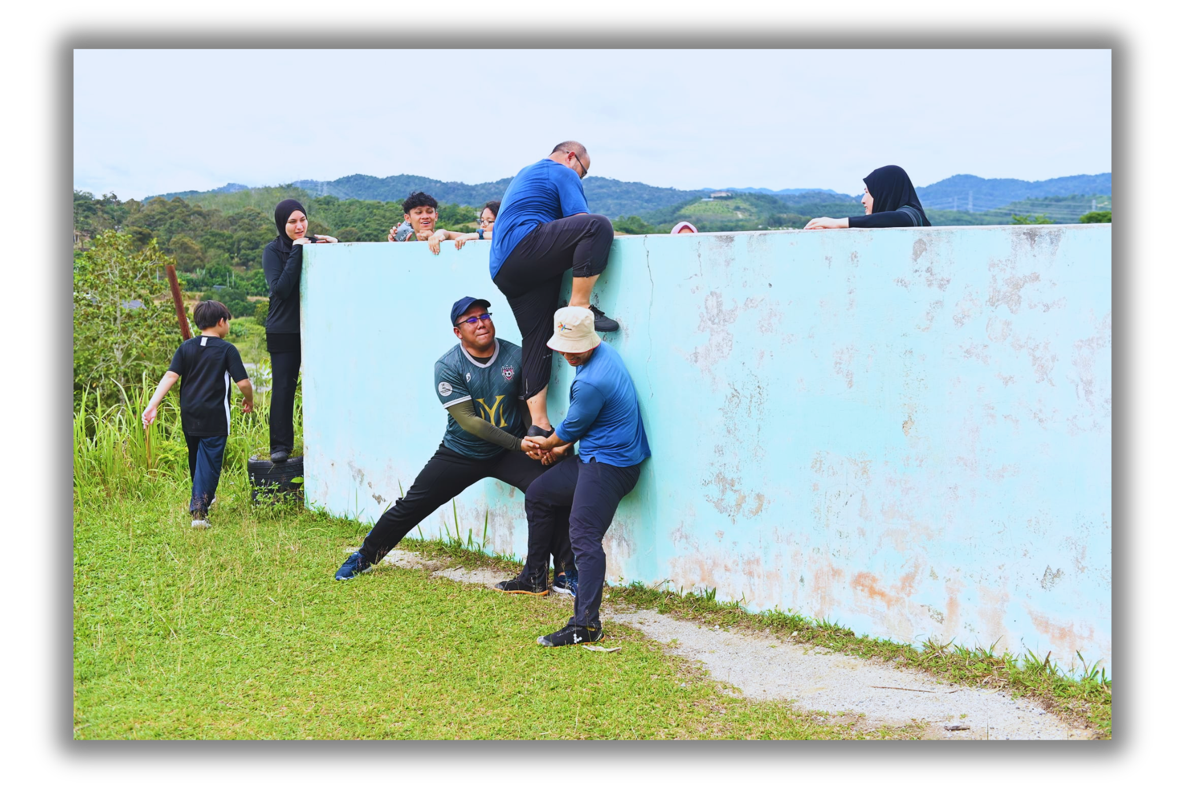
FROM EXPERIENCE TO LEARNING
OBSTACLE COURSE

Slide 4
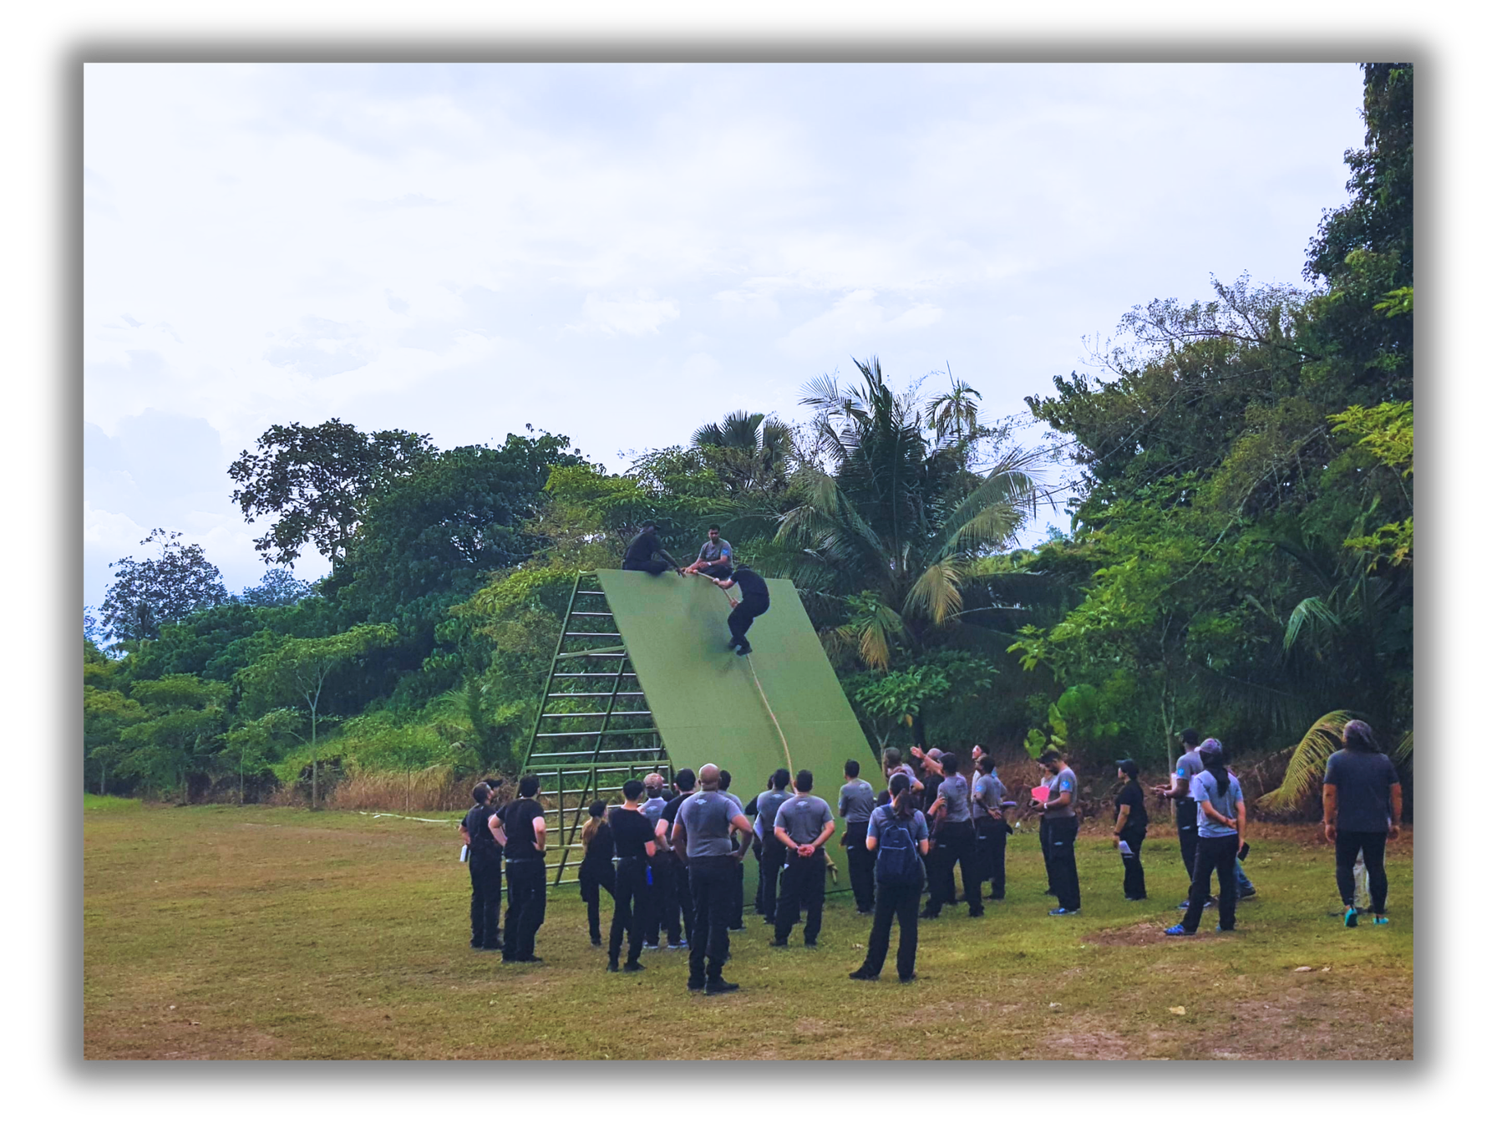
OBSTACLE COURSE

Slide 5
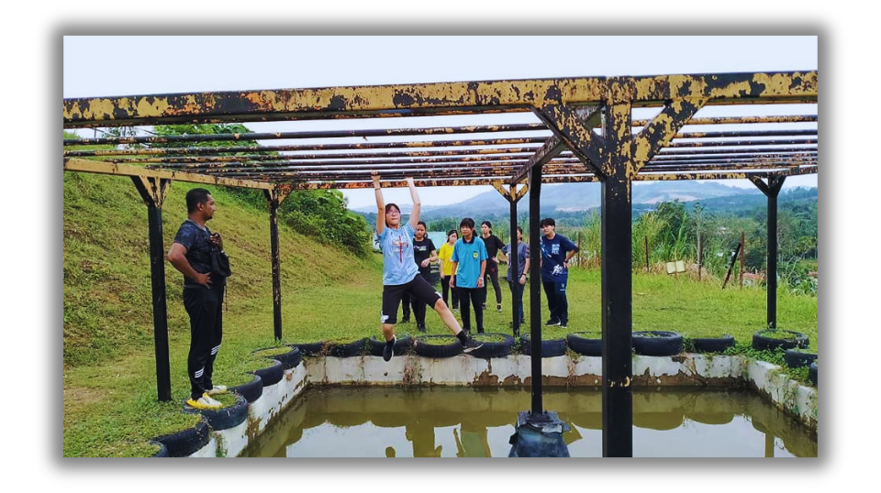
FROM EXPERIENCE TO LEARNING
OBSTACLE COURSE

Slide 6
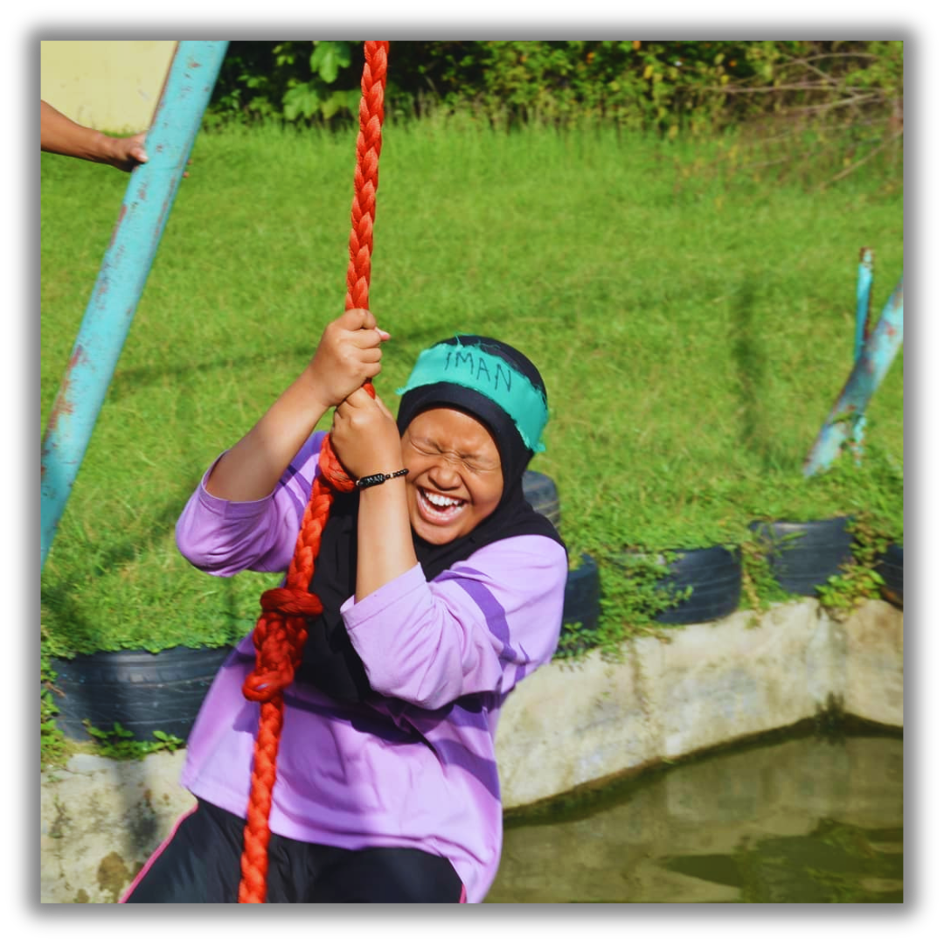
OBSTACLE COURSE

Slide 7
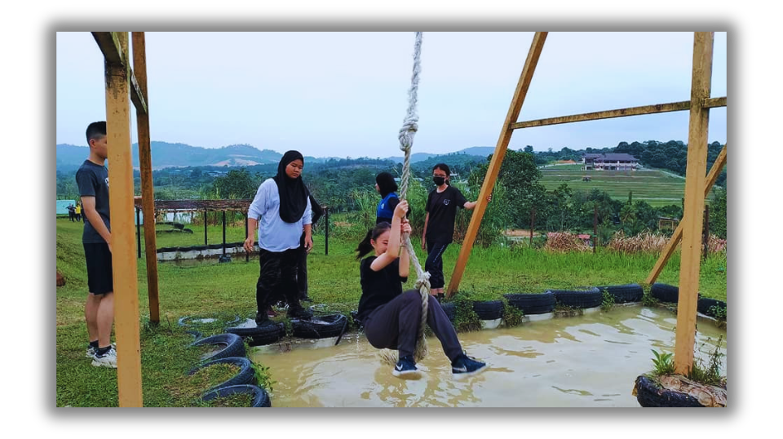
OBSTACLE COURSE

Slide 8
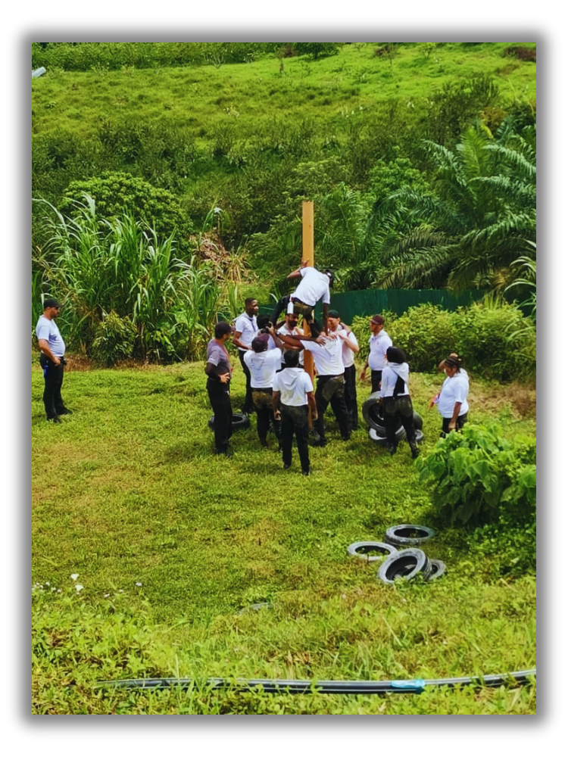
OBSTACLE COURSE

Slide 9

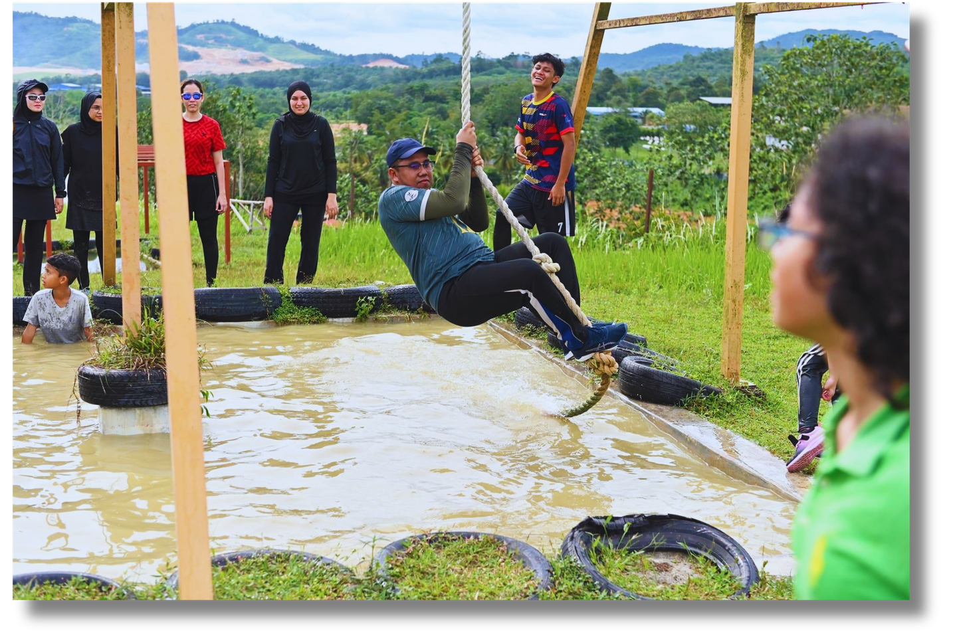

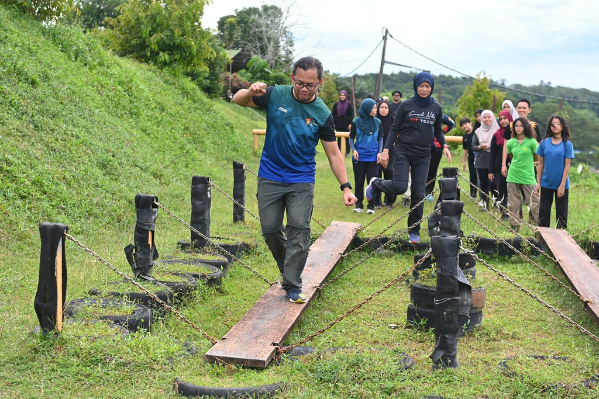

OBSTACLE COURSE

Slide 10
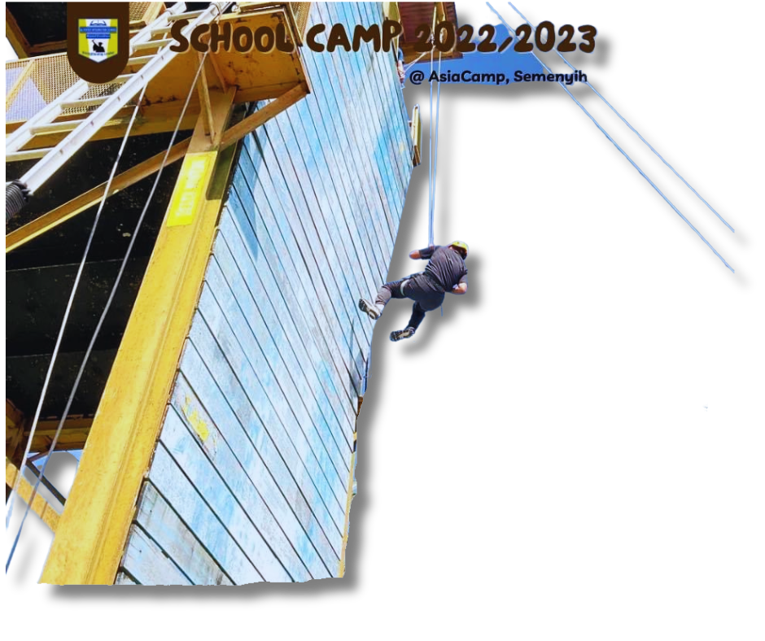
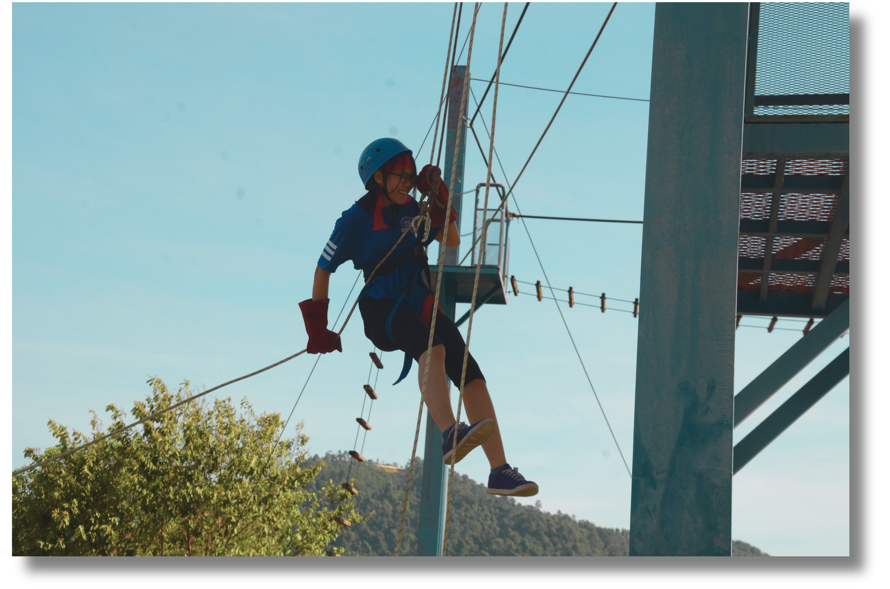
ABSEILLING

Slide 11
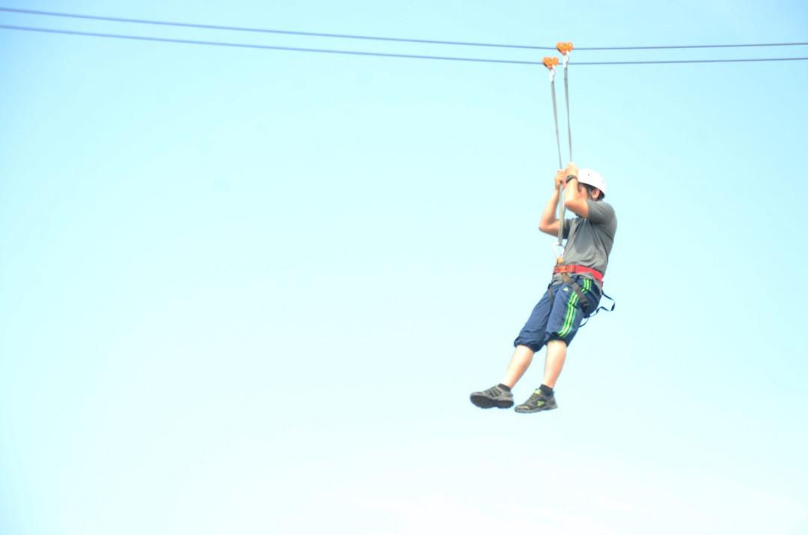
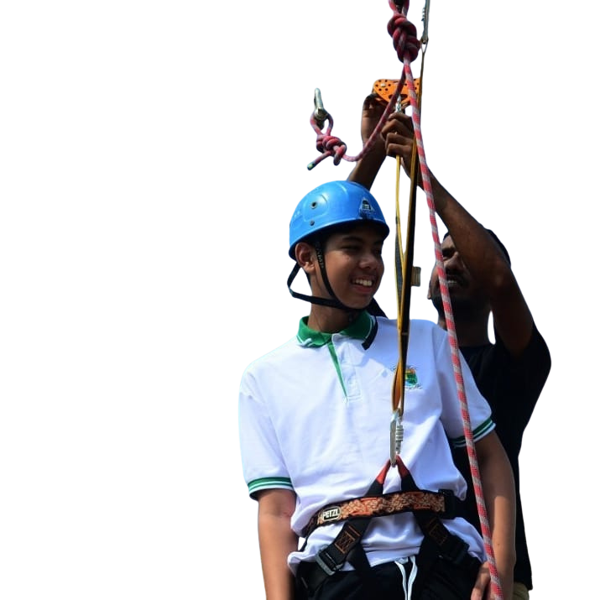
FLYING FOX

Slide 12
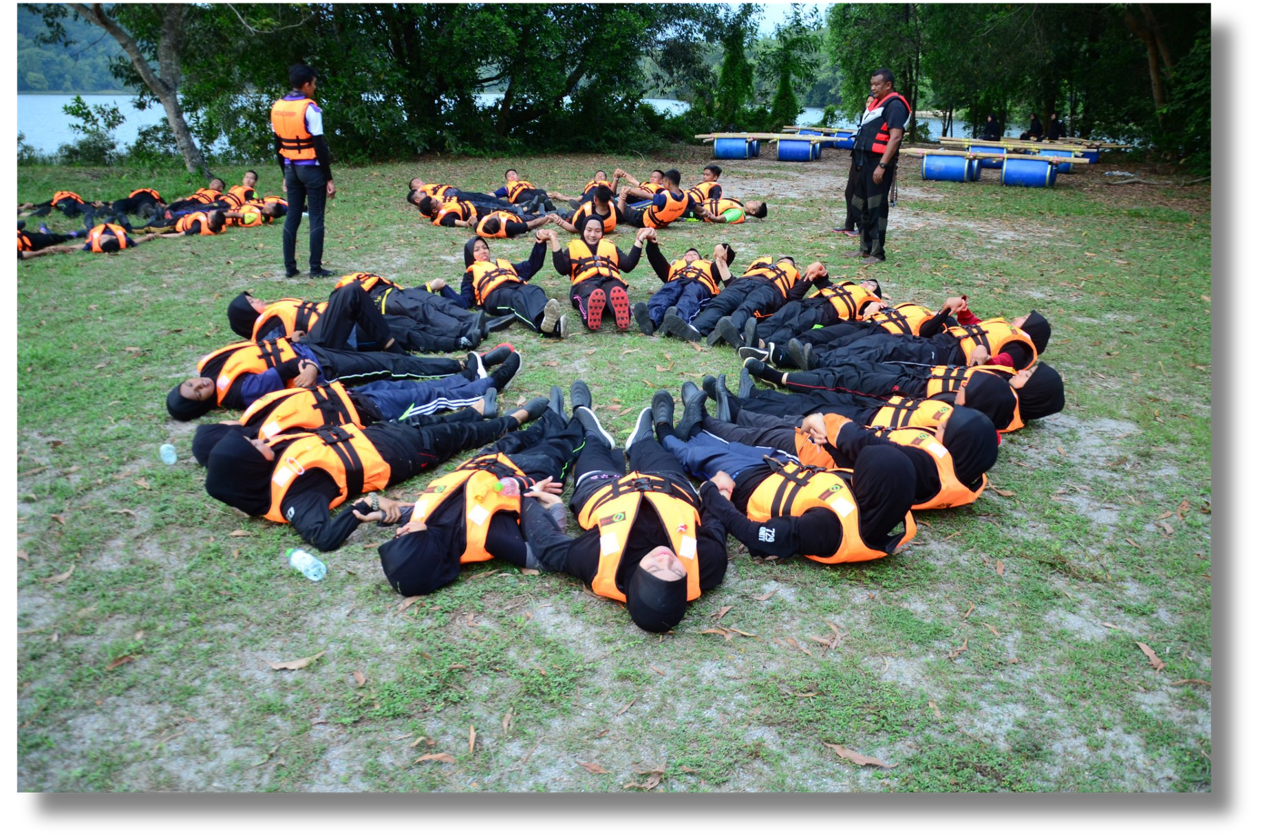
WATER CONFIDENCE

Slide 13
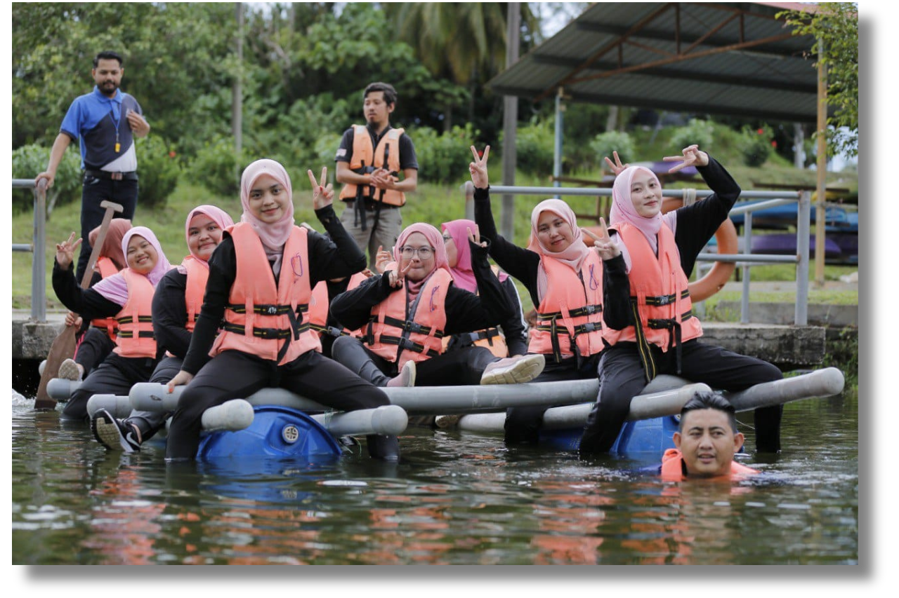
WATER RAFTING

Slide 14
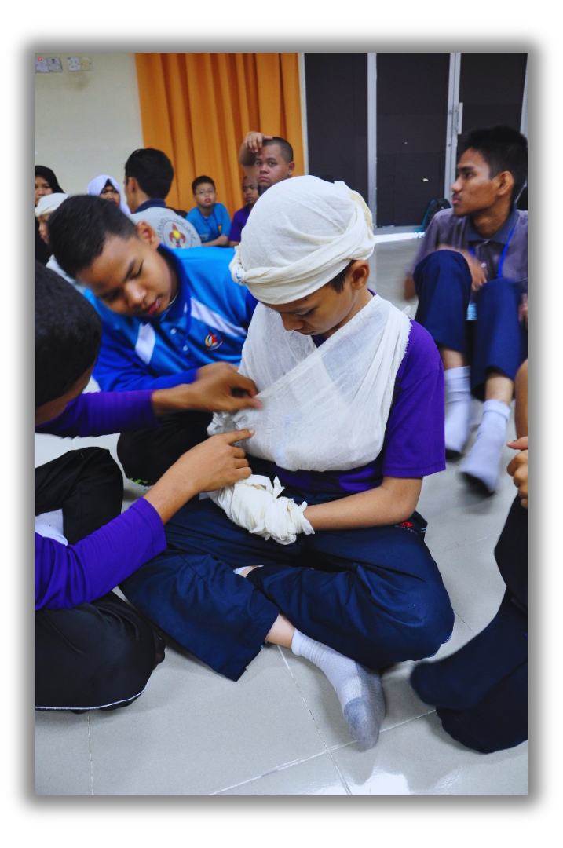
FIRST AID

Slide 15
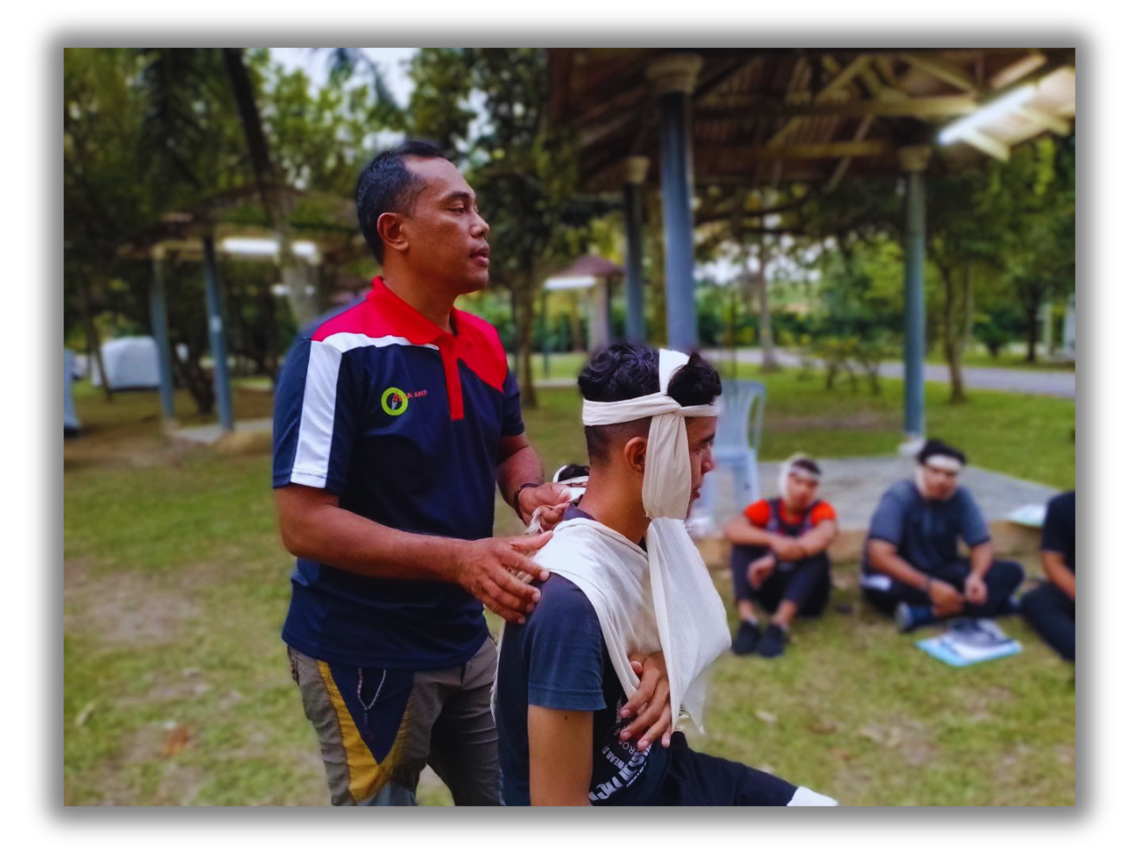
FIRST AID

Slide 16
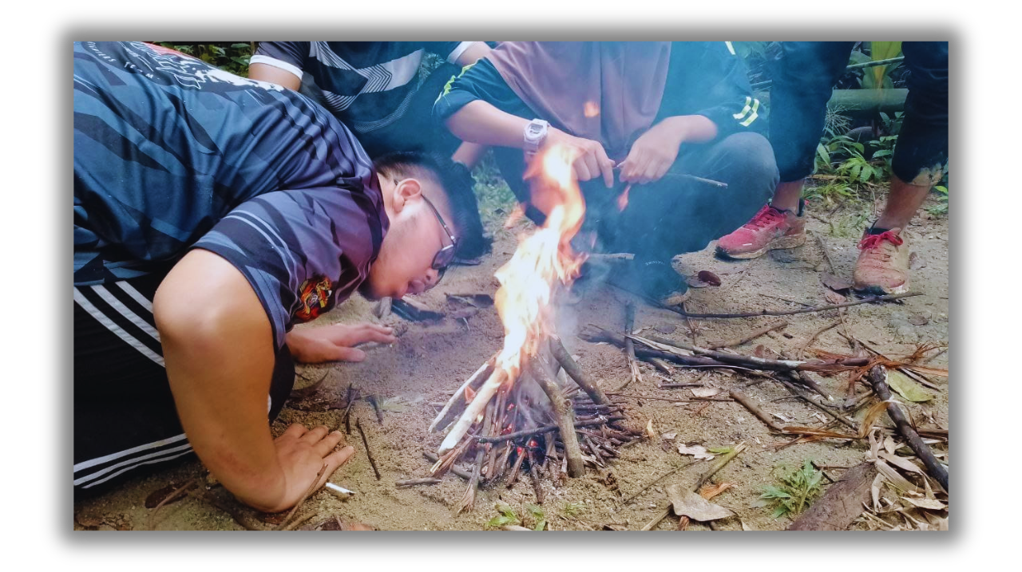
SURVIVAL COOKING

Slide 17
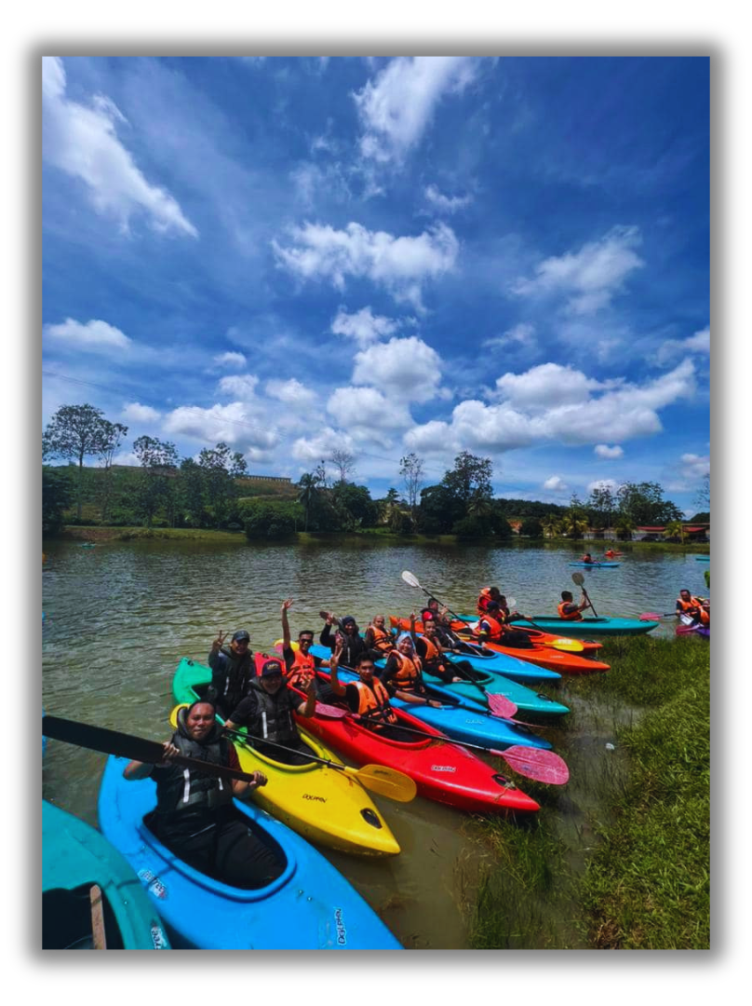
KAYAK

Slide 18
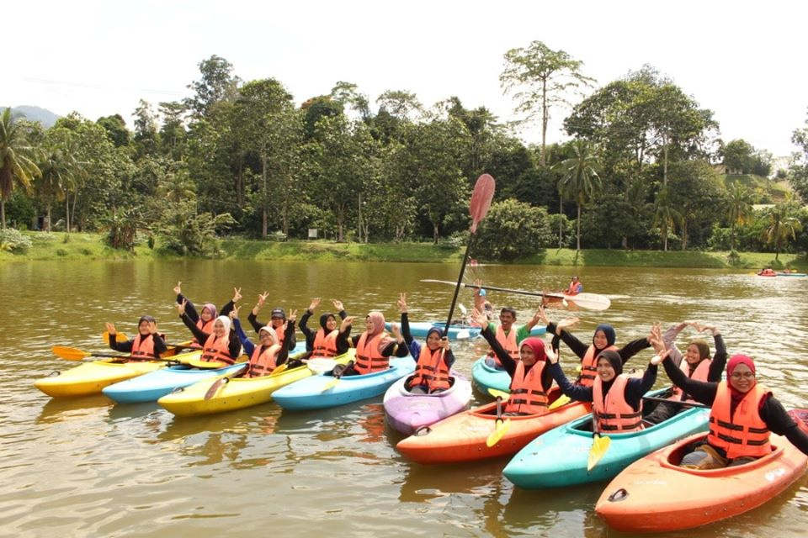
KAYAK

Slide 19
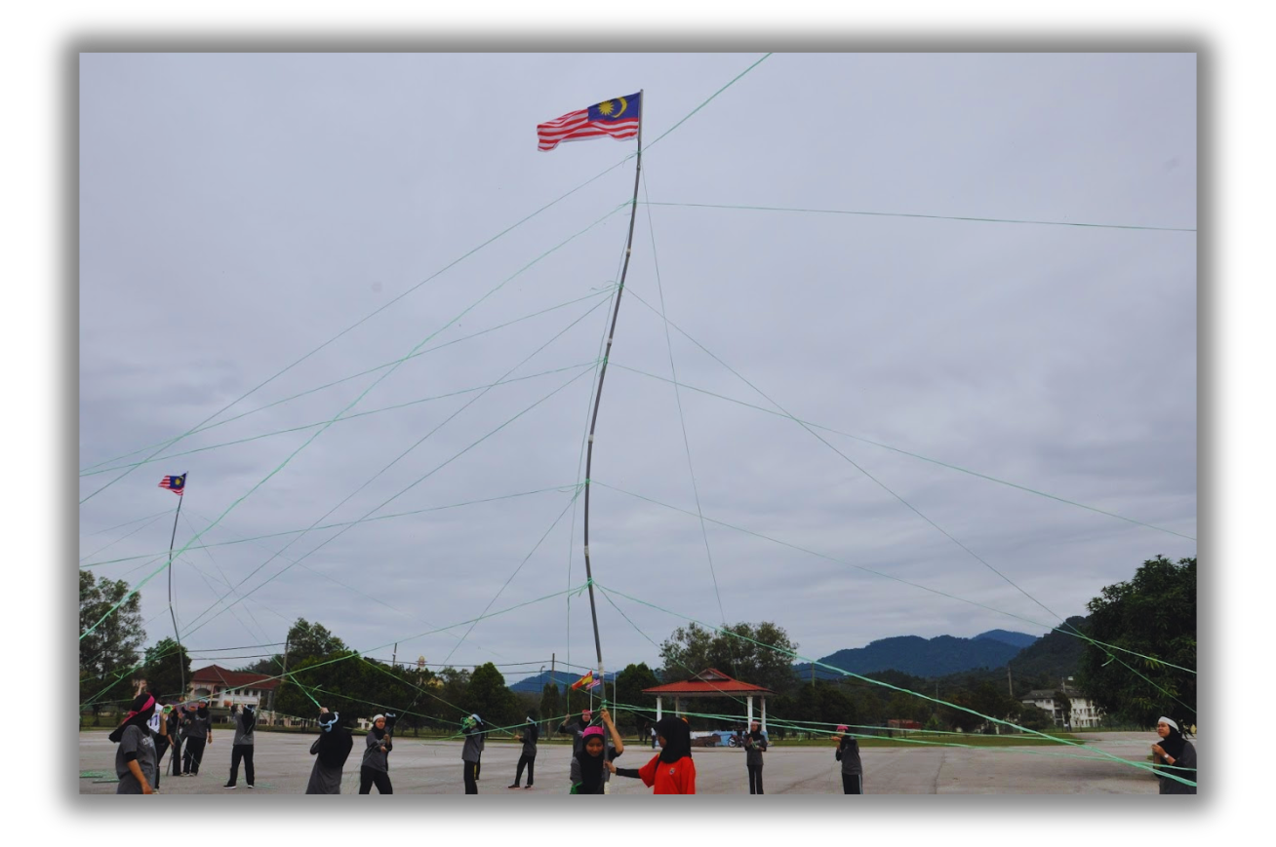
MANAGEMENT GAMES

Slide 20
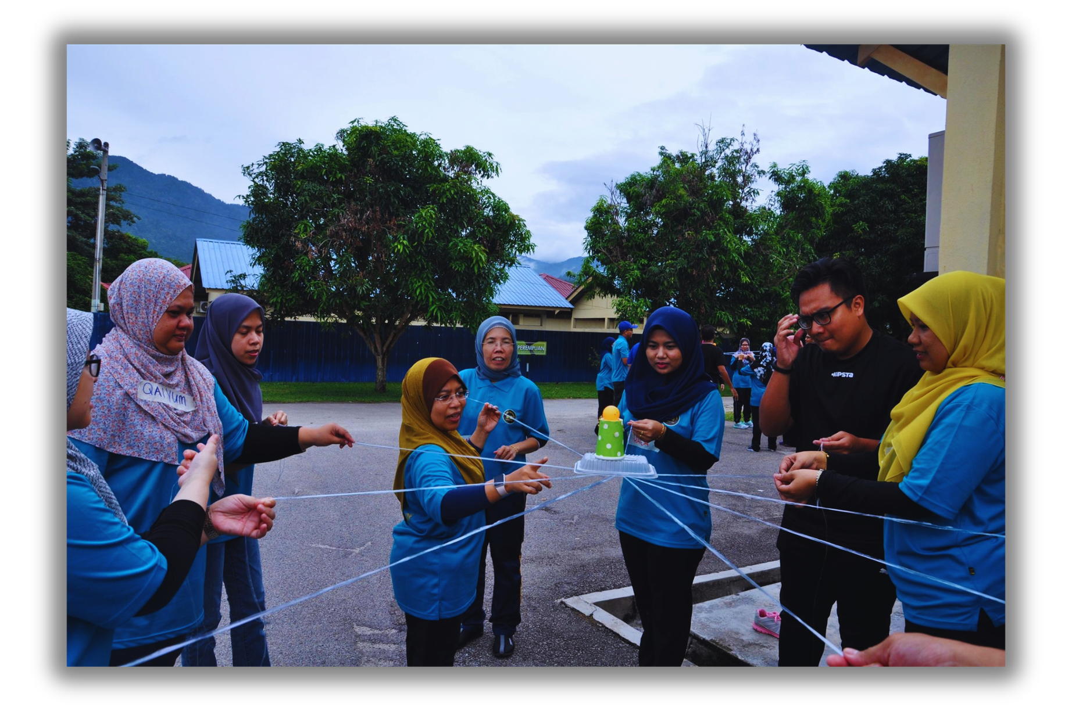
EXPLORACE

Slide 21
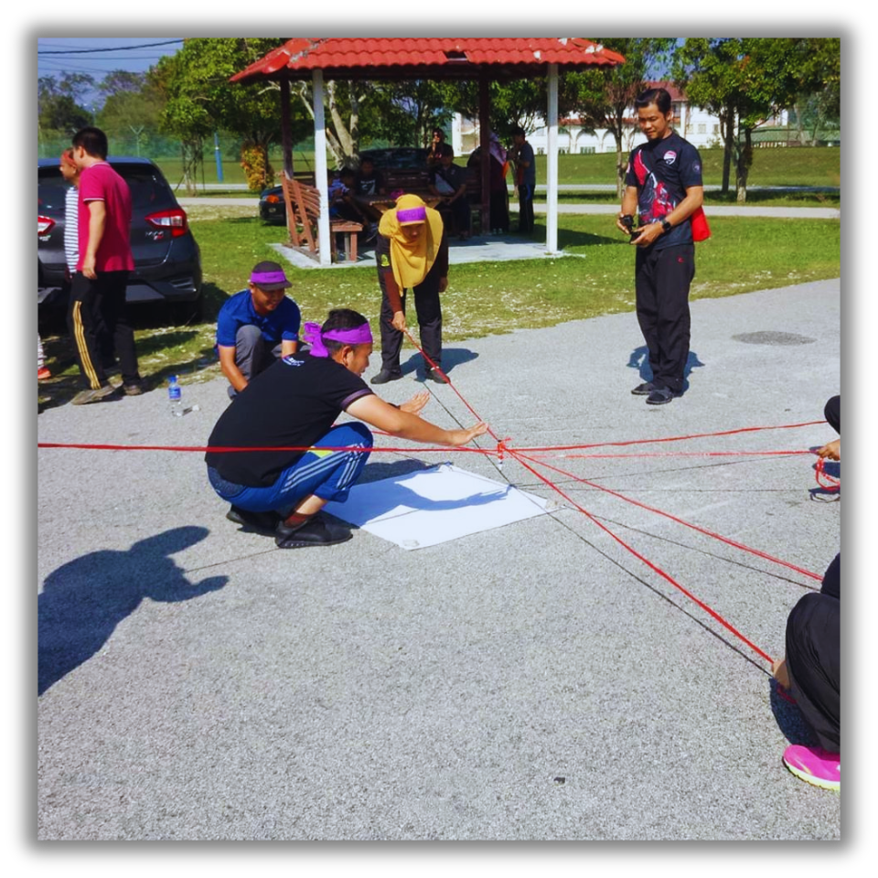
EXPLORACE

Slide 22
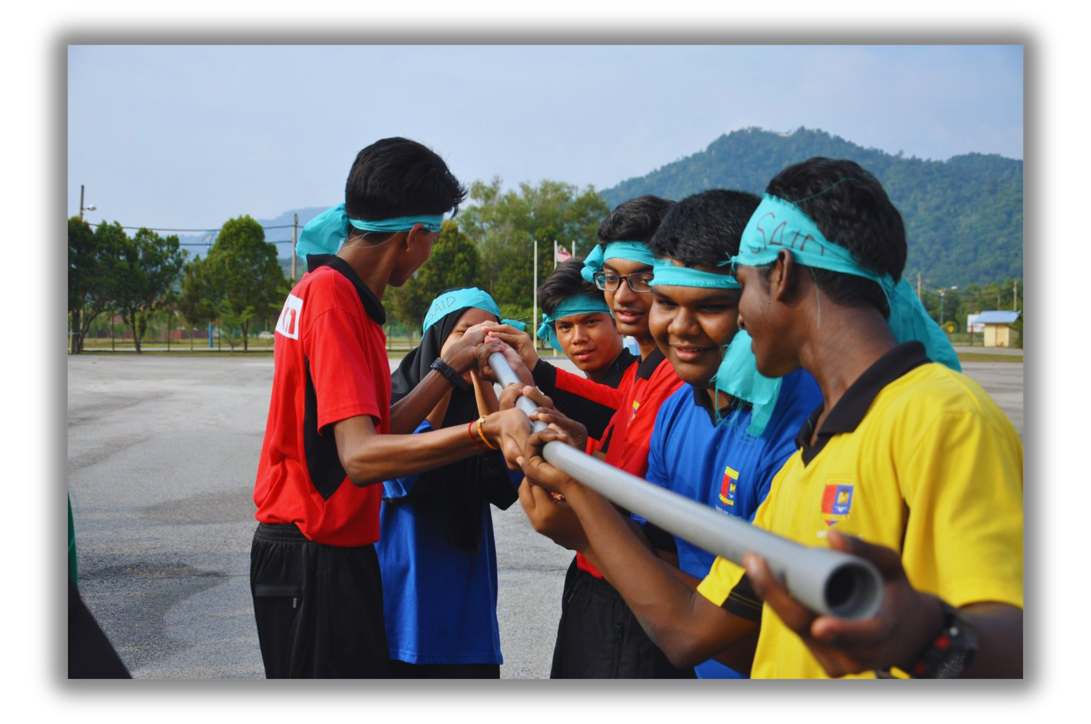
EXPLORACE

Slide 23
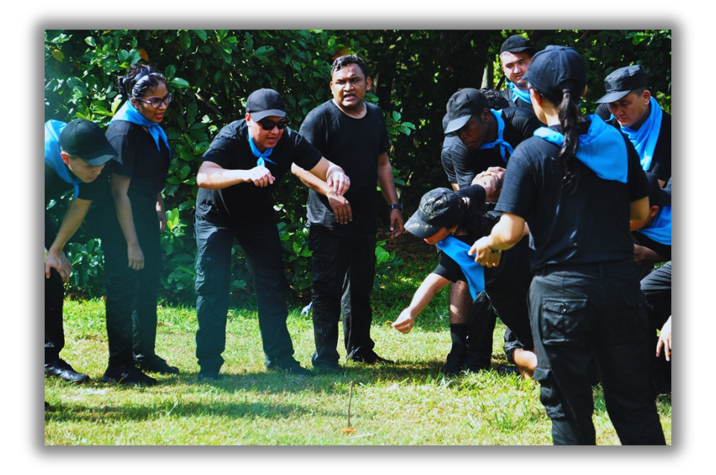
EXPLORACE

Slide 24
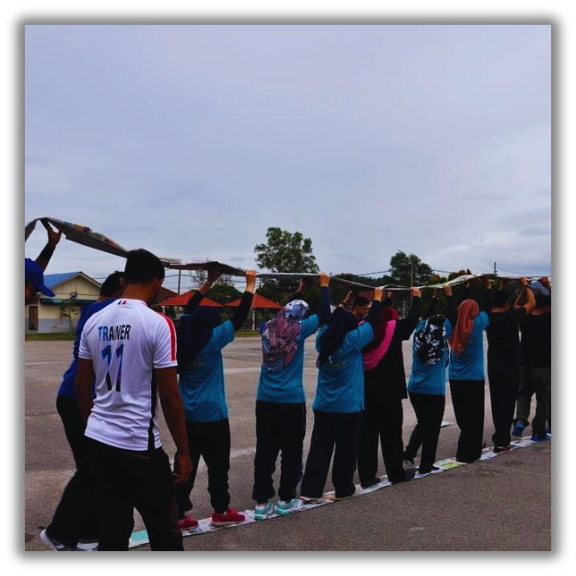
EXPLORACE

Slide 25
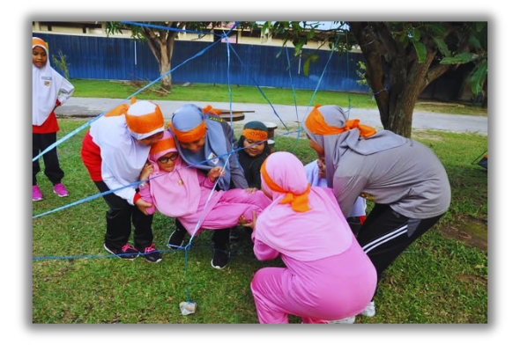
EXPLORACE

Slide 26
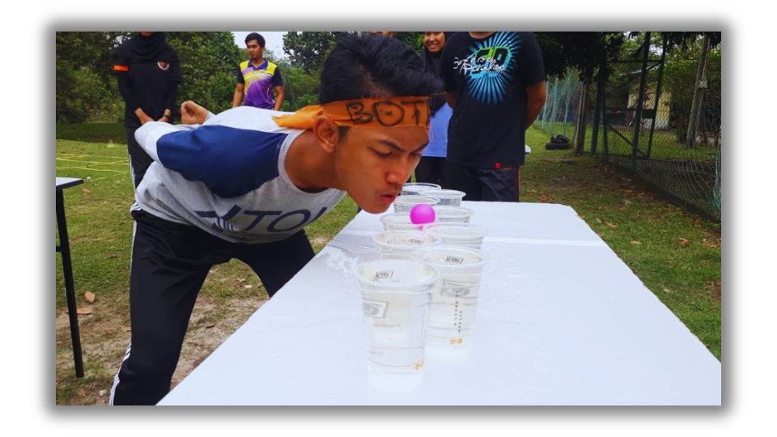
EXPLORACE

Slide 27
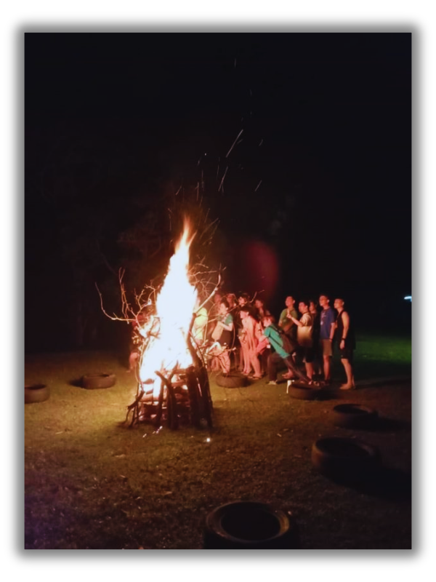
FIRE CAMP

Slide 28
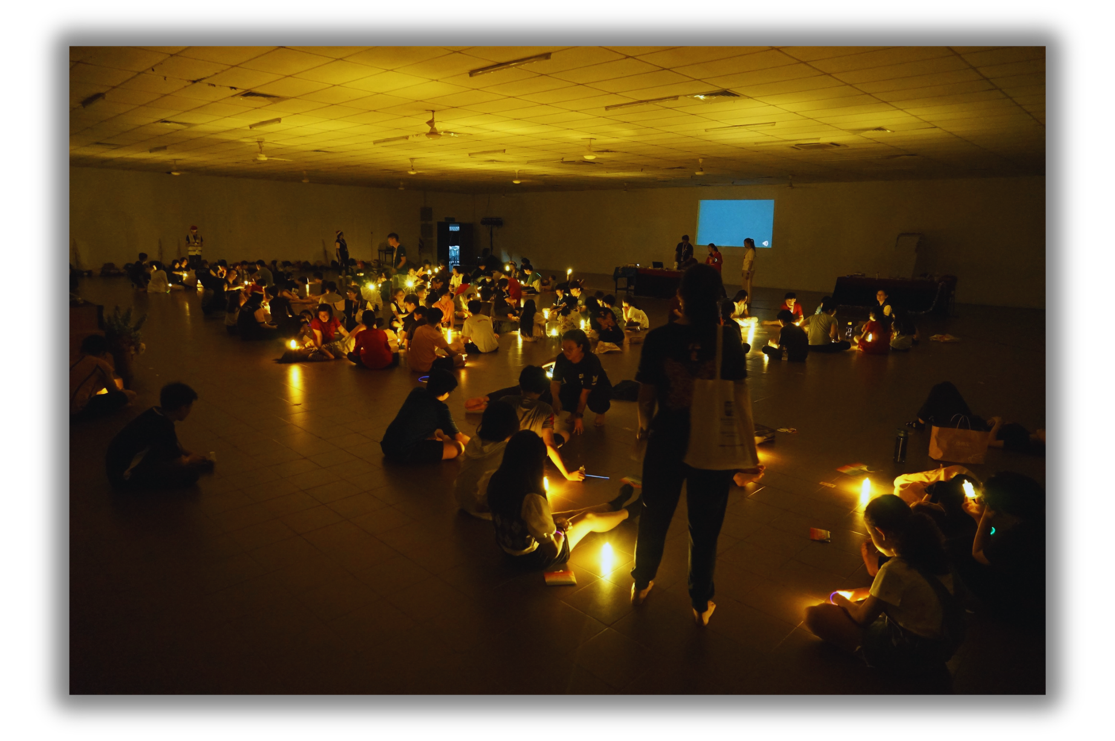
NIGHT WAR

Slide 29
